Slide 1
CRUD operation of database name:PRATIKSHA RUIKAR

Slide 2
CONTENT
Introduction of CRUD database
What is CRUD
Some concept of CRUD
Standard CRUD operations
Application

Slide 3
Introduction of Crud database
Working with a database means one has to manipulate the data that is raw to a meaningful form before one can gain insights into it.
This means one has to perform several operations like read, create, update or delete data pieces.
And those operations are precisely what are called the CRUD operations. Since most databases use SQL.

Slide 4
What is Crud
CRUD stands for the four functions most important in CRUD operations and is an acronym for CRUD- Create, Read, Update and Delete, which is essential to running any storage application and database operations.
A persistent device in the storage means the device even powered off continues to retain power like a solid-state drive or hard disk. In stark contrast, the RAM (random access memory) and cache are great examples of memory that is volatile, meaning they store data that doesn’t get erased even when powered off.

Slide 5
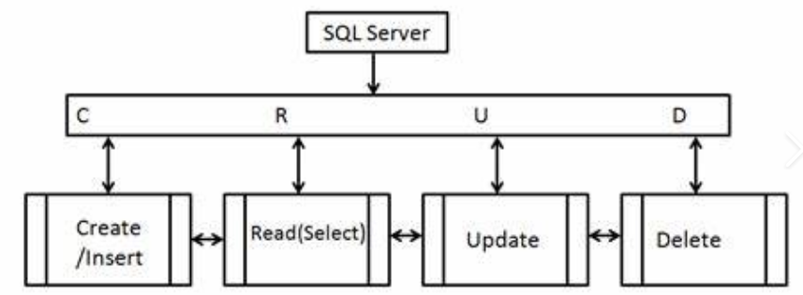

Slide 6
These are the four most basic operations that can be performed with most traditional database systems and they are the backbone for interacting with any database.
The first letter of CRUD, ‘C’, refers to CREATE aka add, insert. In this operation, it is expected to insert a new record using the SQL insert statement. SQL uses INSERT INTO statement to create new records within the table.
The second letter of CRUD , ‘R’, refers to SELECT operation. The word ‘read’ retrieves data or record-set from a listed table(s). SQL uses the SELECT command to retrieve the data. When it comes to executing queries, you can use SQL Server Management Studio or SQL Server Data Tools or sqlcmd, based on your preference.

Slide 7
The third letter of CRUD, ‘U’, refers to Update operation. Using the Update keyword, SQL brings a change to an existing record(s) of the table.
The last letter of the CRUD operation is ‘D’ and it refers to removing a record from a table. SQL uses the SQL DELETE command to delete the record(s) from the table.

Slide 8
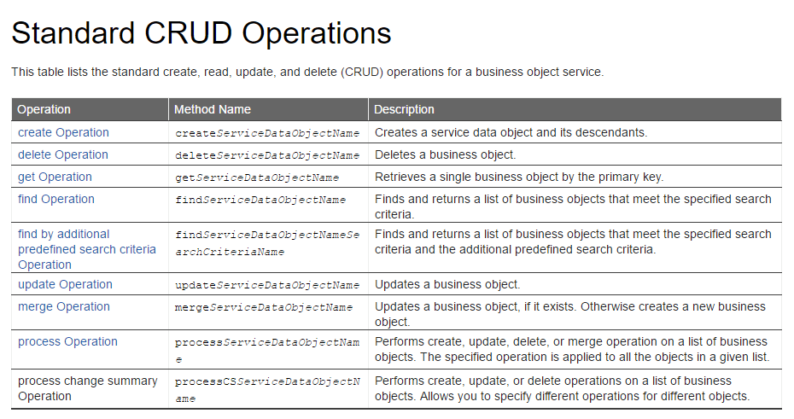

Slide 9
APPLICATIONS OF CRUD
CRUD operations are popular in most RDBMS applications and are versatile functions used in a variety of database, different industry verticals and business models. Let’s take the example of how CRUD is implemented in the human resource application.
CRUD in HR-Human Resources operations:
The HR department normally maintains database records of existing employees to manage staff records and well-being.
An Employees Table with attributes like employee identification number, first and last name, home address, contact number, work location, and such details.
The HR Data Table has attributes like employee ID, employee’s payroll information, social security number, salary etc.
The Locations Table contains attributes like building ID, company’s physical locations, zip code, address, name of the manager, etc., for each physical location etc.

Slide 10
THANK YOU

